Slide 1
Grainger plc
Client Induction (March 2025)

Slide 2

Agenda
Overview of Grainger
Open Box and Grainger history
What we have done for them
What we are doing for them
Key People

Slide 3

Overview of Grainger plc
Company Type: Public
Industry: Real Estate – Private Rented Sector
Founded: 1912
Head Office: Newcastle upon Tyne
They are the largest listed residential landlord in the UK
11 000 + Operational homes
4 730 homes in BTR pipeline

Slide 4
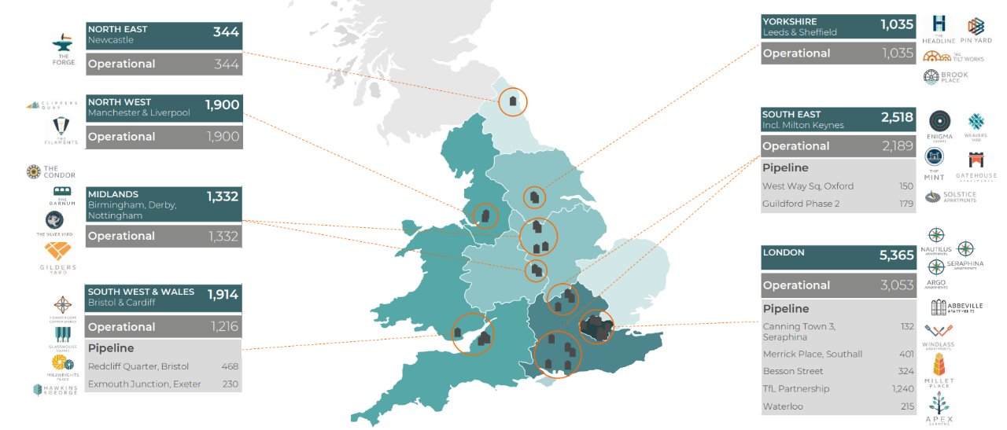
Overview of Grainger plc

Slide 5
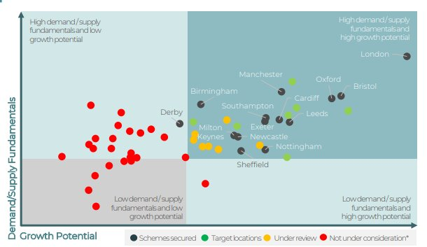
Overview of Grainger plc
Grainger have been at the front of BTR development in the UK
In most of these cities, they are the first to develop a BTR presence
Other large-scale providers often enter at similar times, smaller companies enter the city after the market has stabilised

Slide 6
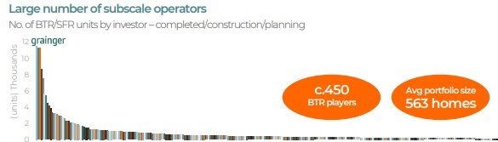
Overview of Grainger plc
Grainger are not a construction company – they do not ‘build’ their own buildings
The process for a new BTR building is typically:
Identify a plot of land in a target city
Work with a construction company to build the building
Take over management of building once construction is complete
Lease up the building
Manage the building
Notes:
That shown in the previous slides
Here they plan and specify the number of units they want of each type, multiple iterations. There is a dev team/onboarding team (furniture etc) and letting feedback/knowledge that gets wrapped in here. Plan and realise the commercial spaces too
Experience re: buildings that graigner ‘buy’ after means that the lettings team/furniture etc is not in situ to start. By being closer from beginning, there is asmoother process for all involved. Other companies typically enter here, they buy the building and have no say on the spec, the number of units etc

Slide 7
Shared History
Key Dates and Milestones
Mar 2024
Support Contract
Mar 2025
CLTL Project
Nov 2022
GPLC's focus
Aug 2023
EoT Start
Mar 2024
Axis Void Project
Jul 2024
Part FTE Starts
Apr 2025
SVOT Foundation
Feb 2021
MRI and ‘Connect’
Apr 2023
Homelet Integration
Jan 2024
EoT End
Nov 2024
Renewal Consulting
Aug 2025
Renewal Project
Feb 2024
RSW Project
Nov 2024
Website Integration
Feb 2025
RTR Project
Form Assembly Project
Apr 2024
Renewal Enhance
Aug 2024
GDPR Anon Proj
Notes:
MRI and connect
Initially came in to try win the MRI business as part of connect
Connect is the name for the digital transformation project, intent to have a number of best in breed systems, connected (nice) across the business
Did not win that
Pointing out the time between
Nov 22
Paul Glibbery met with Sam and others (who) and discussed the vision, that there would be a lot more focus on Salesforce across the business
April 23
First Project – Updating referencing provididers as part of the leasing journey
Aug 23
EoT development Started
In reality, there were months of time before had where there were workshops, scoping etc
Largest project at the time for the Salesforce team
First look for grainger at the Sprint and iterative development methods
Jan 24
EoT released
March 24
Enhancements to the EoT project
Came separately as a need for Grainger, and its massively fortuitious the timing, that would never have been able to be completed in the short time it did if there was not the entire EoT inplace already
Also signed the first Support contract, that is still ongoing and the support hours have been increased, as more and more is now on the salesforce platform
Jul 24
Part FTE started
First time that there was specific cadence of releases, every 4 weeks.
Open Box worked with Grainger to align their other dev cycles with their other systems – end users are getting a lot more out of this now,

Slide 8
Key People
Grainger Team
Paul Glibbery – CIO
Jon Pitt – Director of Lettings
Yvonne Dargavel – Business Change Lead
Patricia Buck – Finance Process & Change Manager
Helen Douglas-Teggart – Salesforce SME
Elisabeta Mihalache – Salesforce SME
Jaic George – Solution Architect
Saji Gunasakeran – Salesforce Admin
Notes:
JP is business owner for Salesforce
YD and PB are on the BOT team, that oversee the projects across all the systems so there is a lot of collaboraiton with them
HDT and EM are across all Salesforce projects, almost sort of like product owners. They assist with process knowledge and with with other end users for UAT, feedback JG is also across all systems, knows the integrations like the back of his hand between everything. He also liases with other consultants for the other systems, especially if there is work for the website/lettings portal/ GREP which is a home made integration layer
SG is the admin and often first line of support for end users

Slide 9











Key People
Open Box Team
Akshat Jain
Anjali Salecha
Jacob Smycz
Khonani Davhana
Matthew Cornfield
Matthew Pitcairn
Nadia Swarts
Nikki Papenfus
Sam Duncan
Sarah Jessiman
Shaun Barret

Slide 10
Questions?

Slide 11




Tips and tricks
How to keep text styles correct when copying from another document
Copy text from the original source.
Select the text in PowerPoint with the correct style and font you’d like to replicate.
Select the edit menu in the top bar, click paste and match formatting (the keyboard shortcut should be visible on the right in grey if you prefer using keyboard shortcuts).
Copy and paste grey icons
Select a grey icon from the icons above the page. See the grey icons above page 4.
Hold the shift key, click and drag the white box down.
Stop dragging when the white box aligns with the top of the page.
v
v
v
v
Choose a page layout from the next two pages that best fits your case study
There is a page with no icons and a page with icons.
The green and grey boxes are move-able and scale-able depending on how much copy you have.
Hold the shift key while scaling elements to keep them in proportion.
Once your case study is complete, delete the pages you don’t need.
Strategy &
Advisory
Analysis &
Consulting
Software
Development
Data &
Analytics
Need help?
Feel free to reach out to Judith or Lori who would gladly assist.

Slide 12






























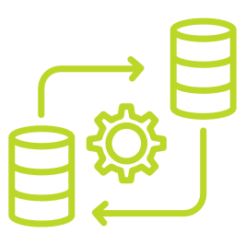







































Icons for use
Use icons to help convey a message, illustrate a concept or when the page is text heavy and needs a visual element
Change colour and thickness of icons
To change icon colour, select the icon, right click, select format graphic, and add a shape fill colour
Icons lines should not look too thick / bulky
If the icon looks too thick, you can add a thin outline to make lines look thinner
Use white outlines on green icons or green outlines on white icons with backgrounds. Play with line thickness to match the look of the icons on this page.
Icons can also be used in Shapes with colour fills

Slide 13











































More icons and logos
Other icons and logo’s relating to case studies specifically
External APIs
React for Front-end Interface
Synapse
ASP.NET Web APIs
Parquet
On Premise SQL Server DB
Azure ML
Azure Active Directory for authentication
SignalR Websockets

Slide 14
v
v
v
v
Strategy &
Advisory
Analysis &
Consulting
Software
Development
Data &
Analytics
To replace icons with grey icons:
Select a grey icon from the icons above this page.
Hold the shift key, click and drag the white box down.
Stop dragging when the white box aligns with the top of the page.
The Client needed predictive models to analyze internal organizational data along with macro and microeconomic data. These models aimed to provide market growth indicators and predicted pricing for the acquisitions team.
Alterra Capital Partners is an Africa-focused private equity firm that partners with exceptional entrepreneurs and management teams to grow their businesses.
Case study eg.1
Machine learning to gain insights for better decision making
The client faced challenges in accurately forecasting market trends and pricing due to the complexity and volume of data involved. Their existing methods lacked
the sophistication needed to combine and analyze diverse data sources effectively. This gap hindered their ability to make informed decisions quickly and confidently when evaluating new acquisition opportunities. They needed a robust solution to overcome these limitations and provide clear, actionable insights to the acquisitions team.
A Data lake was established, along with the required data loading processes.
These processes fed the ML models which in turn returned the predicted output for analysis in Power BI.
Accuracy levels were determined by clear articulation of the required
outcome, available data, associated data quality and the technical application of the appropriate logic.
Insight gain over the technical development cycle
Collection
Traditional ELT/ ETL Processes.
Majority of time spent
Cleaning
Handle missing values, incorrect values, outliers & duplications.
Transformation
Scaling, normalization and feature Engineering.
Integration
Folding multiple datasets into one singular dataset.
Reduction
Dimensional reduction & sampling.
Partitioning applied & ML model training
Training

Slide 15
v
v
v
v
Strategy &
Advisory
Analysis &
Consulting
Software
Development
Data &
Analytics
To replace icons with grey icons:
Select a grey icon from the icons above this page.
Hold the shift key, click and drag the white box down.
Stop dragging when the white box aligns with the top of the page.
Objective: entirely paper-free board meetings to achieve simple, interactive reporting, putting the right information at the executive’s fingertips.
Give a short introduction and blurb about the company then click the box to the right to add the client logo. You can move the logo under this blurb and the quote to the right, or add the logo to the right of this blurb and the quote underneath if you have space.
Case study eg.2
Executive Dashboards
3rd Party Data
Property Manager data held in multiple 3rd party systems
Multiple Sources
Internal data held in several systems that did not talk to each other
Time Sensitive
Shareholder Financial Statements must be accurate and on time
Custom tool connecting PM data to Argus Enterprise
All sources of data integrated to Data Warehouse
SQL Server Data Warehouse – single point of truth
Modelling & Analytics Tool Integration
SSRS Reports for Financial Statements
80% reduction in data collation time
Greater confidence in accuracy and consistency of reports
Enhanced data analysis and increased data security

